Slide 1

How do Users Interact with a Knowledge Graph?

Slide 2
Outline
Interaction Paradigms
Visualization Techniques
Structured Query Interfaces
Natural Language Query Interfaces

Slide 3
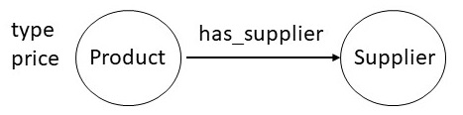
Interaction Paradigms
Schema provides an overview of the knowledge graph

Slide 4
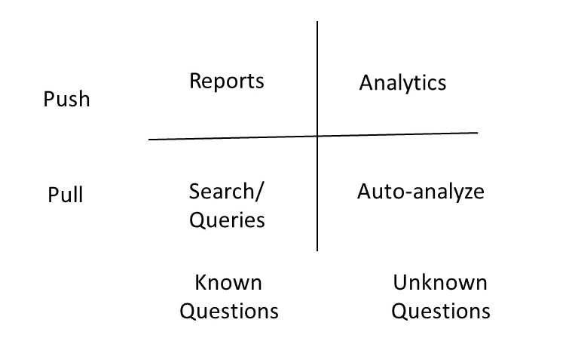
Interaction Paradigms

Slide 5
Interaction Paradigm
The interface to a knowledge graph is a combination of
Keyword search
Structured queries
Tabular presentation
Graph visualization
The user interface to a knowledge graph may not even expose the graph

Slide 6
Visualization Techniques
General principles
Best practices

Slide 7
General Principles
Amplify the user understanding of data

Slide 8
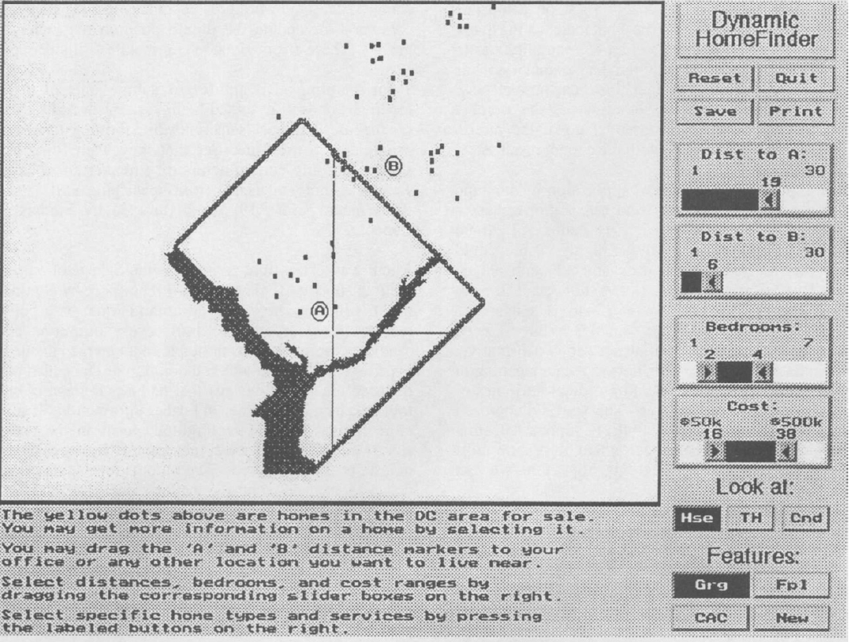
General Principles
Amplify the user understanding of data
Present more information than a user might be able to remember at a time

Slide 9
General Principles
Amplify the user understanding of data
Take away the burden of having to look for information

Slide 10
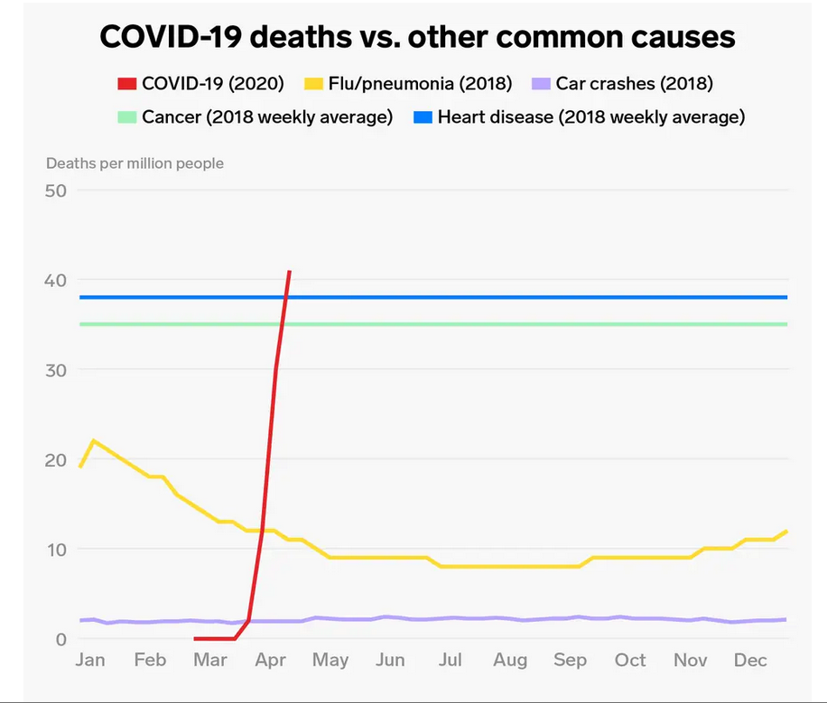
General Principles
Amplify the user understanding of data
Place relevant data next to each other

Slide 11
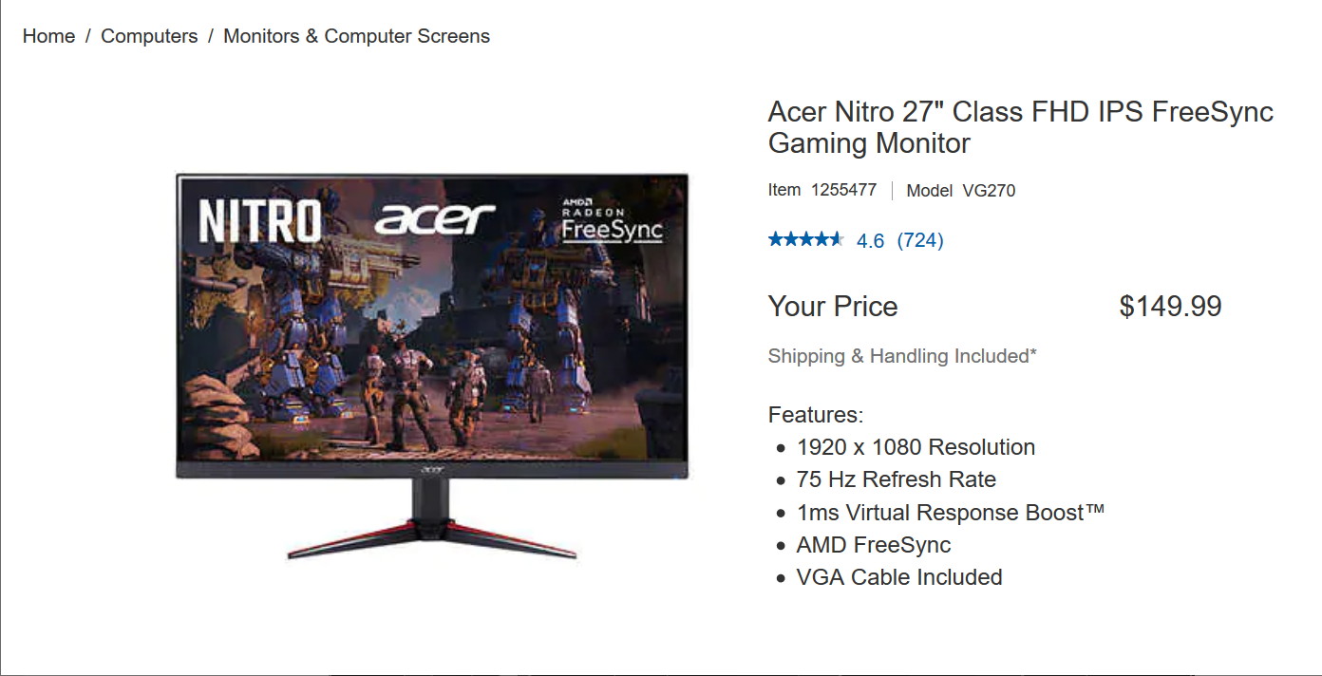
General Principles
Amplify the user understanding of data
Keep track of user’s attention

Slide 12
General Principles
Amplify the user understanding of data
Provide more abstract view through omission and recoding of information

Slide 13
General Principles
Amplify the user understanding of data
Allow a user to interact with and manipulate the visualization

Slide 14
General Principles
Amplify user understanding of data
Present more information than a user might be able to remember at a time
Take away the burden of having to look for information
Place relevant data next to each other
Keep track of user’s attention
Provide more abstract view through omission and recoding of information
Allow a user to interact with and manipulate the visualization

Slide 15
General Principles
Amplify the user understanding of data
Design Choices
Spatial substrate
Marks
Connections and enclosures
Retinal properties
Temporal encoding

Slide 16
General Principles
Amplify the user understanding of data
Design Choices
Spatial substrate
Marks
Connections and enclosures
Retinal properties
Temporal encoding
Geographical data naturally
shown on a map
For non-geographic data choose suitable axes and coordinates

Slide 17
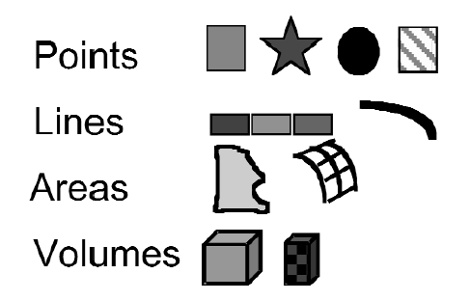
General Principles
Amplify the user understanding of data
Design Choices
Spatial substrate
Marks
Connections and enclosures
Retinal properties
Temporal encoding
Visible things that happen in space that help a user in distinguishing between data items

Slide 18
General Principles
Amplify the user understanding of data
Design steps
Spatial substrate
Marks
Connections and enclosures
Retinal properties
Temporal encoding
Connections include graphs, trees, and other hierarchical organization
We can draw enclosures around certain nodes

Slide 19
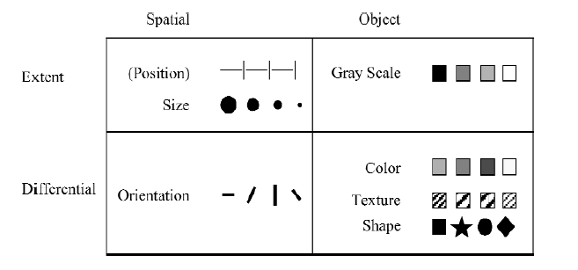
General Principles
Amplify the user understanding of data
Design Choices
Spatial substrate
Marks
Connections and enclosures
Retinal properties
Temporal encoding
Color, crispness, hue, transparency can be used to make a point

Slide 20
General Principles
Amplify the user understanding of data
Design Choices
Spatial substrate
Marks
Connections and enclosures
Retinal properties
Temporal encoding
Animation of data as it changes over time can help understand its evolution over a period of time

Slide 21
General Principles
Amplify the user understanding of data
Design Choices
Visualization type
Simple
Composed
Interactive
Attentive-Reactive

Slide 22
General Principles
Amplify the user understanding of data
Design Choices
Visualization type
Simple
Composed
Interactive
Attentive-Reactive
Static mapping of data into up to three dimensions

Slide 23
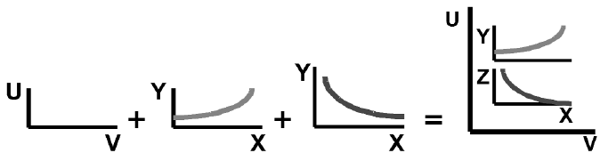
General Principles
Amplify the user understanding of data
Design Choices
Visualization type
Simple
Composed
Interactive
Attentive-Reactive
Combined visualization

Slide 24
General Principles
Amplify the user understanding of data
Design Choices
Visualization type
Simple
Composed
Interactive
Attentive-Reactive
User selectively controls, expands, and navigates
Movable filters
Dynamic queries
Overview + Detail

Slide 25
General Principles
Amplify the user understanding of data
Design Choices
Visualization type
Simple
Composed
Interactive
Attentive-Reactive
The system anticipates what is most useful thing to display next
Calculate degree of interest

Slide 26
Visualization Techniques
General principles
Best practices

Slide 27
Visualization Techniques
Best Practices
Five step design process
Identify variables that could be mapped to spatial positions
Combine mappings to increase dimensionality
Use retinal properties to add more dimensions
Add controls for user interaction
Consider attentive reactive capabilities

Slide 28
Visualization Techniques
Best Practices
Five step design process
Design template
Overview
Dynamic queries
Zooming in
Details on demand
Retrieval by example

Slide 29
Outline
Interaction Paradigms
Visualization Techniques
Structured Query Interfaces
Natural Language Query Interfaces

Slide 30
Structured Queries
The queries conform to a pre-defined grammar
System uses auto-completion in response to user’s input

Slide 31
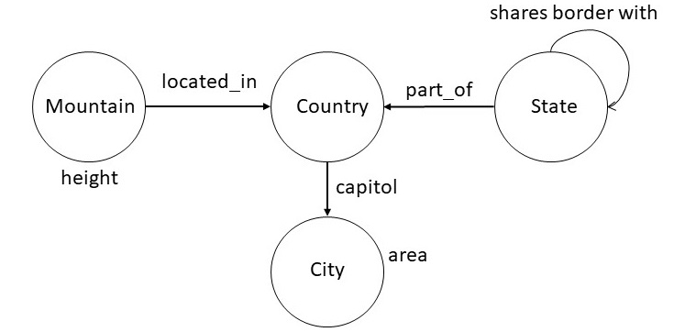
Structured Queries
city with largest area
top five cities by area
countries whose capitals have area at least 500 squared kilometers
states bordering Oregon and Washington
second tallest mountain in France
Example

Slide 32
Structured Queries
Can be specified using a BNF Grammar
<np> ::= <noun> "and" <noun>
<np> ::= <geographical-region> |
<geographical-region> <spatial-relation> <geographical-region>
<geographical-region> ::= "capital of country" | "city" | "country" |
"mountain" | "river" | "state"
<property> ::= "area" | "height"
<aggregate-relator> ::= "with the most number of" | "with the largest" |"with"
<aggregate-modifier> ::= "top" <number> | "second tallest"
<spatial-relation> ::= "bordering" | "inside"
<number-constaint> ::= "atleast" <quantity>
<quantity> ::= <number> <unit>
<unit> ::= "Square Kilometer"
<ranking> ::= "by"

Slide 33
Structured Queries
Can be specified using a BNF Grammar
<np> ::= <noun> "and" <noun>
<np> ::= <geographical-region> |
<geographical-region> <spatial-relation> <geographical-region>
<geographical-region> ::= "capital of country" | "city" | "country" |
"mountain" | "river" | "state"
<property> ::= "area" | "height"
<aggregate-relator> ::= "with the most number of" | "with the largest" |"with"
<aggregate-modifier> ::= "top" <number> | "second tallest"
<spatial-relation> ::= "bordering" | "inside"
<number-constaint> ::= "atleast" <quantity>
<quantity> ::= <number> <unit>
<unit> ::= "Square Kilometer"
<ranking> ::= "by"
city with the largest area
<geographical-region> <aggregate-relator> <property>

Slide 34
Structured Queries
Can be specified using a BNF Grammar
<np> ::= <noun> "and" <noun>
<np> ::= <geographical-region> |
<geographical-region> <spatial-relation> <geographical-region>
<geographical-region> ::= "capital of country" | "city" | "country" |
"mountain" | "river" | "state"
<property> ::= "area" | "height"
<aggregate-relator> ::= "with the most number of" | "with the largest" |"with"
<aggregate-modifier> ::= "top" <number> | "second tallest"
<spatial-relation> ::= "bordering" | "inside"
<number-constaint> ::= "atleast" <quantity>
<quantity> ::= <number> <unit>
<unit> ::= "Square Kilometer"
<ranking> ::= "by"
top five cities by area
<aggregate-modifier> <geographical-region> <ranking> <property>

Slide 35
Structured Queries
Can be specified using a BNF Grammar
<np> ::= <noun> "and" <noun>
<np> ::= <geographical-region> |
<geographical-region> <spatial-relation> <geographical-region>
<geographical-region> ::= "capital of country" | "city" | "country" |
"mountain" | "river" | "state"
<property> ::= "area" | "height"
<aggregate-relator> ::= "with the most number of" | "with the largest" |"with"
<aggregate-modifier> ::= "top" <number> | "second tallest"
<spatial-relation> ::= "bordering" | "inside"
<number-constaint> ::= "atleast" <quantity>
<quantity> ::= <number> <unit>
<unit> ::= "Square Kilometer"
<ranking> ::= "by"
countries whose capitals have area at least 500 squared kilometers
<geographical-region> <aggregate-relator> <geographical-region>
<aggregate-relator> <property> <number-constraint> <quantity>

Slide 36
Structured Queries
Grammar allows us
To check for legal queries
To auto-complete queries
To suggest completions of partial queries

Slide 37
Structured Queries
Improving the range of queries requires
Expanding the grammar
Well-suited only for limited domains
Not designed to handle numerous variations in English language

Slide 38
Outline
Interaction Paradigms
Visualization Techniques
Structured Query Interfaces
Natural Language Query Interfaces

Slide 39
Natural Language Query Interface
Semantic Parsing Technology
Begin with a minimal grammar
Train the semantic parser to choose most likely interpretation

Slide 40
Natural Language Query Interface
Semantic Parsing System
Executor
Grammar
Parser
Model
Learner

Slide 41
Natural Language Query Interface
Semantic Parsing System
Executor
Grammar
Model
Parser
Learner
Produces a SPARQL or Cypher query that could be executed by the query engine

Slide 42
Natural Language Query Interface
Semantic Parsing System
Executor
Grammar
Model
Parser
Learner
a grammar is set of rules of the form α ⇒ β
Maps input sentence to logical forms
NP(x) with the largest RelNP(r) ⇒ argmax(1,1,x,r)
top NP(n) NP(X) by the RelNP(r) ⇒ argmax(1,n,x,r)
NP(x) has RelNP(r) at least NP(n) ⇒ (< arg(x,r) n)

Slide 43
Natural Language Query Interface
Semantic Parsing System
Executor
Grammar
Model
Parser
Learner
Grammar produces multiple interpretations
A model defines a probability distribution over those interpretations

Slide 44
Natural Language Query Interface
Semantic Parsing System
Executor
Grammar
Model
Parser
Learner
Parser maintains a certain number of interpretations at each step
Computes the most likely interpretation

Slide 45
Natural Language Query Interface
Semantic Parsing System
Executor
Grammar
Model
Parser
Learner
Computes the parameters of the model and in some cases additions to the grammar

Slide 46
Natural Language Query Interface
Extremely difficult problem
Requires amassing a large amount of training data
Most systems report accuracy in the range of 50-60%

Slide 47
Summary
Users want to consume a knowledge graph in different modes
Pull vs push and interactive vs batch
We must not assume that a graphical visualization is the best display
Graphs are usually effective for schema but not always for instances
Ideal interfaces will use a combination of method
Leverage visualization design principles

